Slide 1
Team-Based Learning: A Transformative Teaching Tool
Dr. Laura Madson
NMSU Department of Psychology
Lilly Conference – Evidence-Based Teaching and Learning
January 10, 2020
Austin, TX

Slide 2
Acknowledgements
Dr. Larry Michaelsen
Professor of Management, University of Central Missouri
Jim Sibley
Director of the Centre for Instructional Support at the Faculty of Applied Science at University of British Columbia
Bill Roberson and Tine Reimers
Center for Innovation and Excellence in Learning at Vancouver Island University

Slide 3
Presentation and other resources

Slide 4
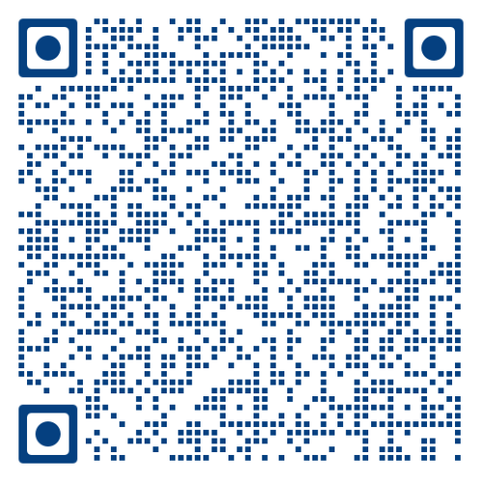
Learning objectives
By the end of the session, attendees will be able to:
Describe the key elements of TBL
Report on their first-hand experiences with TBL
Learn more about TBL to decide whether to adopt TBL principles

Slide 5
Overview
The instructor strategically assigns students to permanent, diverse teams
Students are held accountable for completing pre-class preparation
Class time focuses on strategically-designed team activities; instructor facilitates activities within and across teams, clarifying murky concepts and helping students compare ideas
Same problem
Significant problem
Specific choice
Simultaneous response
Final grades:
Individual performance
Team performance
Peer evaluation
Notes:
In TBL courses:
The instructor strategically assigns students to permanent, diverse teams;
Students are held accountable for completing pre-class preparation;
The majority of class time focuses on strategically-designed team application activities that engage students with the material and with each other. The instructor facilitates these activities both within and across teams, clarifying murky concepts and helping students compare ideas.
Final grades include performance on tasks that students complete as individuals, performance on team tasks, and a peer evaluation completed by each student’s teammates assessing the student’s overall contribution to the team.

Slide 6
Team formation and introductions

Slide 7
What do employers want?
Notes:
From May 17 to June 1, 2018, Hart Research Associates conducted an online survey on behalf of the Association of American Colleges and Universities among employers at companies that have at least 25 employees and report that 25% or more of their new hires hold either an associate’s degree from a two-year college or a bachelor’s degree from a four-year college.
The research includes two parallel surveys:
▪ One among 501 business executives at private sector and nonprofit organizations, including owners, CEOs, presidents, C-suite level executives, vice presidents, and directors;
▪ One among 500 hiring managers, or non-executives (directors, managers, supervisors, and office administrators) whose current job responsibilities include recruiting, interviewing, and/or hiring new employees.

Slide 8
Team Activity
Pick the skill that is MOST important for students to have developed in college:
The ability to effectively communicate with others
Critical thinking and analytical reasoning skills
Ethical judgment and decision-making
The ability to work effectively with others in teams
The ability to apply knowledge and skills to real-world settings

Slide 9
5:00

Slide 10
4:30

Slide 11
4:00

Slide 12
3:30

Slide 13
3:00

Slide 14
2:30

Slide 15
2:00

Slide 16
1:30

Slide 17
1:00

Slide 18
:30

Slide 19
:15

Slide 20
Time’s Up!

Slide 21
Simultaneous Report
Pick the skill that is MOST important for students to have developed in college:
The ability to effectively communicate with others
Critical thinking and analytical reasoning skills
Ethical judgment and decision-making
The ability to work effectively with others in teams
The ability to apply knowledge and skills to real-world settings

Slide 22
Reflection
4Ss
What kind of thinking/discussion took place in your team?
Comparison/contrast
Analysis
Evaluation
Decision-making

Slide 23
Questions?

Slide 25
Team Formation
Instructor assigns students to permanent teams at beginning of term
Create diverse teams of 5-7 students
maximize team resources
minimize team liabilities
eliminate existing relationships that inhibit team cohesion

Slide 26
Team Readiness Assessment Test
Team decision
Scratch to find star
Multiple chances but rewards first-chance correct answers
1 scratch = 4 points
2 scratches = 2 points
3 scratches = 1 point

Slide 27
Teams work because…
They are permanent
Strategically formed by the instructor
Peer evaluations reduce social loafing
Team tasks are designed properly

Slide 28
Good team activities
Significant problem
Same problem
4 S’s
Specific choice
Simultaneous response
Notes:
Four characteristics of good team activities
1. Significant problem
Same question
Specific choice
Simultaneous response
TEAMS MUST BE GIVEN TIME IN CLASS TO COMPLETE TEAM ACTIVITIES.

Slide 29
Process not product
Example team tasks
Evaluative judgement – best/worst, most/least
Ranking
Sorting
Gallery walk
Notes:
Gallery walk – teams post product around the room; students circulate through the room reading other team’s work. Helps to have a team rep stay by the product and to give circulating students a decision to make (e.g., best poster, most creative).
Scenario/MC – provide teams with information and ask them to make an evaluative decision about the information (e.g., best/worst, most/least). Decision can be framed as a multiple choice item if you want to limit the universe of possible options. Use Psych DO eval as an example.
Pinpointing – dry cleaners; in a painting/poem/film/story pinpoint examples of a phenomenon
Sorting – putting examples of a concept into appropriate categories; given a list of behaviors, sort them into the appropriate psychological disorder; given a list of quotes, sort them into the appropriate historical period

