Slide 1
Teach STEM with Team-Based Learning
Dr. Laura Madson
Department of Psychology
New Mexico State University
DACC
April 5, 2024

Slide 2
Acknowledgements
Dr. Larry Michaelsen
Emeritus Professor of Management, University of Central Missouri
Jim Sibley
Director of the Centre for Instructional Support at the Faculty of Applied Science at University of British Columbia
Bill Roberson and Tine Reimers
Center for Innovation and Excellence in Learning at Vancouver Island University

Slide 3
Presentation

Slide 4
Learning objectives
By the end of the session, attendees will be able to:
Describe the key elements of TBL
Report on their first-hand experiences with TBL
Learn more about TBL to decide whether to adopt TBL principles

Slide 5
Advantages of TBL
Improved academic outcomes
Class is fun and engaging
Build friendships
Greater perceived social support and belongingness
Interpersonal and team skills
Communication skills (e.g., sharing one’s opinion even when it differs from one’s teammates)
Greater appreciation of other’s opinions and cooperative leadership skills
Emotional intelligence
Autonomy
Improved team-adaptability
Attendance
Critical thinking
Problem-solving skills
Course grades
Performance on course exams
Performance on standardized exams
Improved non-academic outcomes

Slide 6
Overview
The instructor strategically assigns students to permanent, diverse teams
Students are held accountable for completing pre-class preparation via Readiness Assurance Process
Class time focuses on strategically-designed team activities; instructor facilitates activities within and across teams, clarifying murky concepts and helping students compare ideas
Same problem
Significant problem
Specific choice
Simultaneous response
Final grades:
Individual performance
Team performance
Peer evaluation
Notes:
TBL provides two types of situation-specific motivation to collaborate meaningfully with teammates. One pillar of TBL is that students are held accountable for their own performance, but also for their team’s performance and their contributions to their team (FeedbackFruits, 2023). Accountability for the quality of their team’s performance on team tasks is usually accomplished by incorporating team performance into students’ final grade (Sibley & Ostafichuk, 2014). Accountability for students’ contributions to their team generally takes the form of a peer evaluation, where students rate the quality of their teammates’ contributions to the team. These ratings become part of the final grade as well (Cestone et al., 2008; Lane, 2012). The result is that students are motivated to work constructively with their teammates as one step toward earning a desirable grade in the class. Beyond earning a good grade, permanent teams, and activities that facilitate positive collaboration also create a sense of social responsibility to one’s team and teammates that may be more motivating in the face of day-to-day distractions than the relatively distal consequence of a grade (Sweet & Pelton-Sweet, 2009).

Slide 7
Team Formation
Instructor assigns students to permanent teams at beginning of term
Create diverse teams of 5-7 students
maximize team resources
minimize team liabilities
eliminate existing relationships that inhibit team cohesion

Slide 8
Team Formation and Introductions
Line up in order by number of years you’ve been teaching at DACC
Notes:
Teams of 3-4; online folks will have to go in and out of a break room (BLECH)

Slide 9
Readiness Assurance Process
Holds students accountable for completing pre-class preparation
Individual and team portions followed by appeals process
Multiple variations; demo canonical version today

Slide 10
Individual Readiness Assurance Test (iRAT)
Which of the following is NOT one of the four characteristics of good team activities?
Simultaneous response
Self-relevant problem
Same problem
Specific choice
Significant problem

Slide 11
Team Readiness Assurance Test (tRAT)
Which of the following is NOT one of the four characteristics of good team activities?
Simultaneous response
Self-relevant problem
Same problem
Specific choice
Significant problem

Slide 12
Readiness Assurance Test - Debriefing
How would taking iRATs and tRATs affect student’s…
…preparation for class?
…understanding of course material?
…ability to communicate their knowledge to others?

Slide 13
Readiness Assurance Process - Variations
Appeals included or not
iRAT in class or before class
Confidence responding or not
tRAT using Immediate Feedback Assessment Forms (IF-ATs)
Individual accountability in other forms
Notes:
Individual and team accountability.
Team accountability is critical for practice articulating knowledge to others AND to team cohesion.

Slide 14
Readiness Assurance Test - Team
Team decision
Scratch to find star
Multiple chances but rewards first-chance correct answers
1 scratch = 4 points
2 scratches = 2 points
3 scratches = 1 point

Slide 15
Team Activity
Which skill is MOST important for students to develop in your classes?
The ability to work effectively in teams
Critical thinking skills
Ability to analyze and interpret data
The ability to apply knowledge and skills to real-world settings
Digital literacy
Notes:
Top five skills rated as Very Important by execs and hiring managers
From 2021 AACU report “How College Contributes to Workforce Success: Employer Views on What Matters Most”
This report presents findings from an online survey that was conducted in October 2020 by the Association of American Colleges and Universities in partnership with Hanover Research.
The total respondent sample of 496 included equal numbers of executives and hiring managers who are responsible for making hiring and promotion decisions in US companies of various types and sizes across a wide range of industries (see fig. 1). Only respondents representing organizations at which a minimum of 25 percent of entry-level positions are filled by employees who hold an associate’s or bachelor’s
degree were eligible for participation. The survey respondents are collectively referred to as “employers” throughout the report.
SEE ALSO https://www.naceweb.org/career-readiness/competencies/career-readiness-defined/

Slide 16
Simultaneous Report
Which skill is MOST important for students to develop in your classes?
The ability to work effectively in teams
Critical thinking skills
Ability to analyze and interpret data
The ability to apply knowledge and skills to real-world settings
Digital literacy

Slide 17
Reflection
4Ss
What kind of thinking/discussion took place in your team?
Comparison/contrast
Analysis
Evaluation
Decision-making

Slide 18
Process not product
Example team tasks
Evaluative judgement – best/worst, most/least
Ranking
Sorting
Gallery walk
Notes:
Gallery walk – teams post product around the room; students circulate through the room reading other team’s work. Helps to have a team rep stay by the product and to give circulating students a decision to make (e.g., best poster, most creative).
Scenario/MC – provide teams with information and ask them to make an evaluative decision about the information (e.g., best/worst, most/least). Decision can be framed as a multiple choice item if you want to limit the universe of possible options. Use Psych DO eval as an example.
Pinpointing – dry cleaners; in a painting/poem/film/story pinpoint examples of a phenomenon
Sorting – putting examples of a concept into appropriate categories; given a list of behaviors, sort them into the appropriate psychological disorder; given a list of quotes, sort them into the appropriate historical period

Slide 19
Questions?

Slide 20
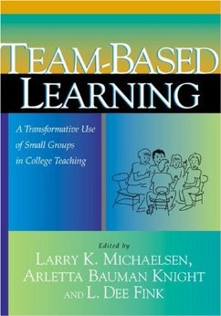
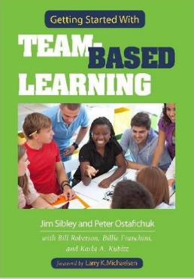
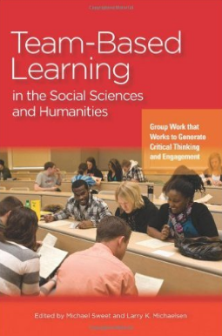
Learn more…
Team-Based Learning Collaborative
Learn TBL
Team-Based Learning: A Transformative Use of Small Groups in College Teaching by Larry K. Michaelsen, Arletta Bauman Knight, L. Dee Fink (Editor)
Team-Based Learning: Small Group Learning's Next Big Step: New Directions for Teaching and Learning, Number 116 by Larry K. Michaelsen, Michael Sweet, Dean X. Parmelee
Team-Based Learning in the Social Sciences and Humanities: Group Work that Works to Generate Critical Thinking and Engagement by Michael Sweet, Larry K. Michaelsen
Getting Started with Team-Based Learning by Jim Sibley and Peter Ostafichuk
Psychology in Everyday Life (5th Ed) by Laura Madson

